Slide 1
PERKS Admin
Dashboard

Slide 2
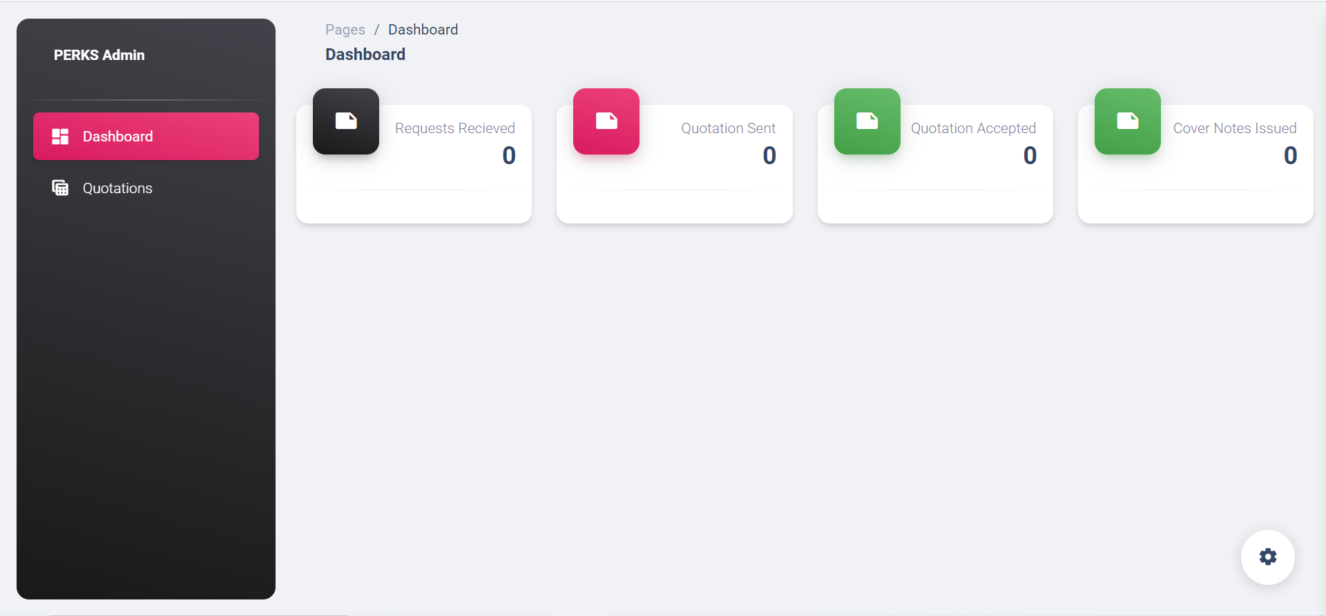
To have option to select period and year ie from when to when eg Jan 2023 to June 2023 and the dashboard below will show details for the period selected
To correct spelling. Should be “Received”

Slide 3
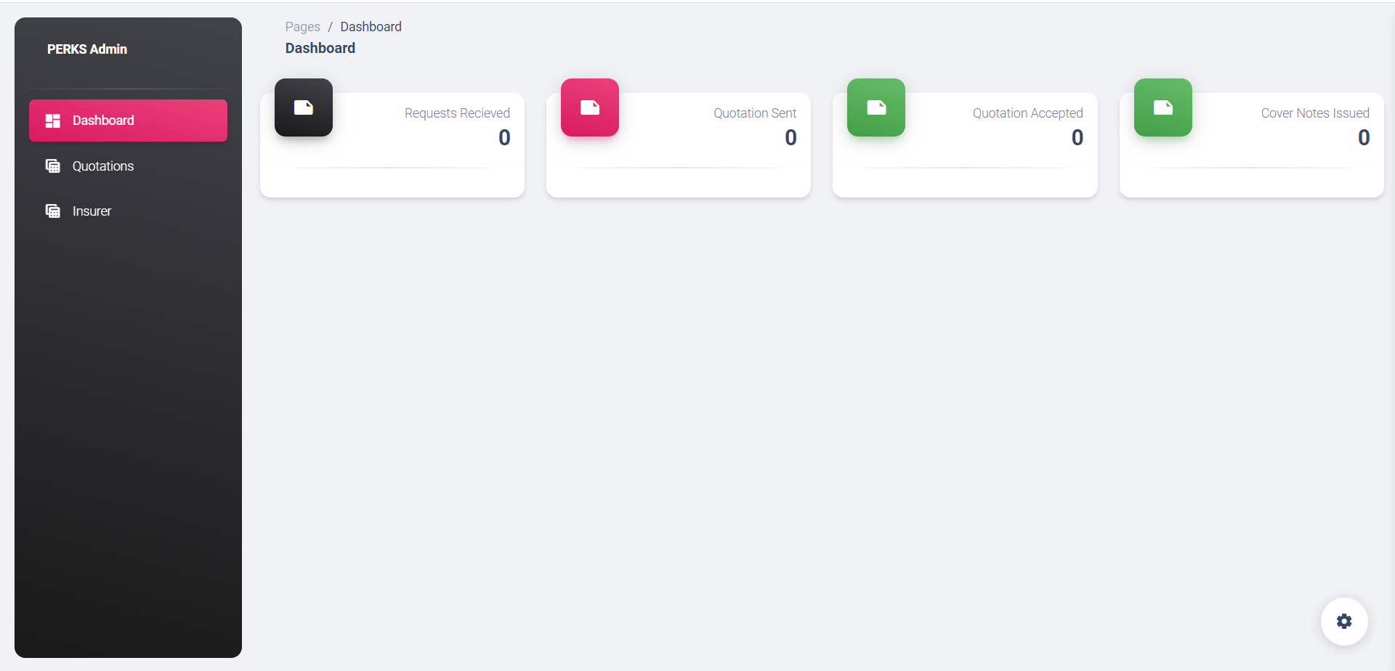
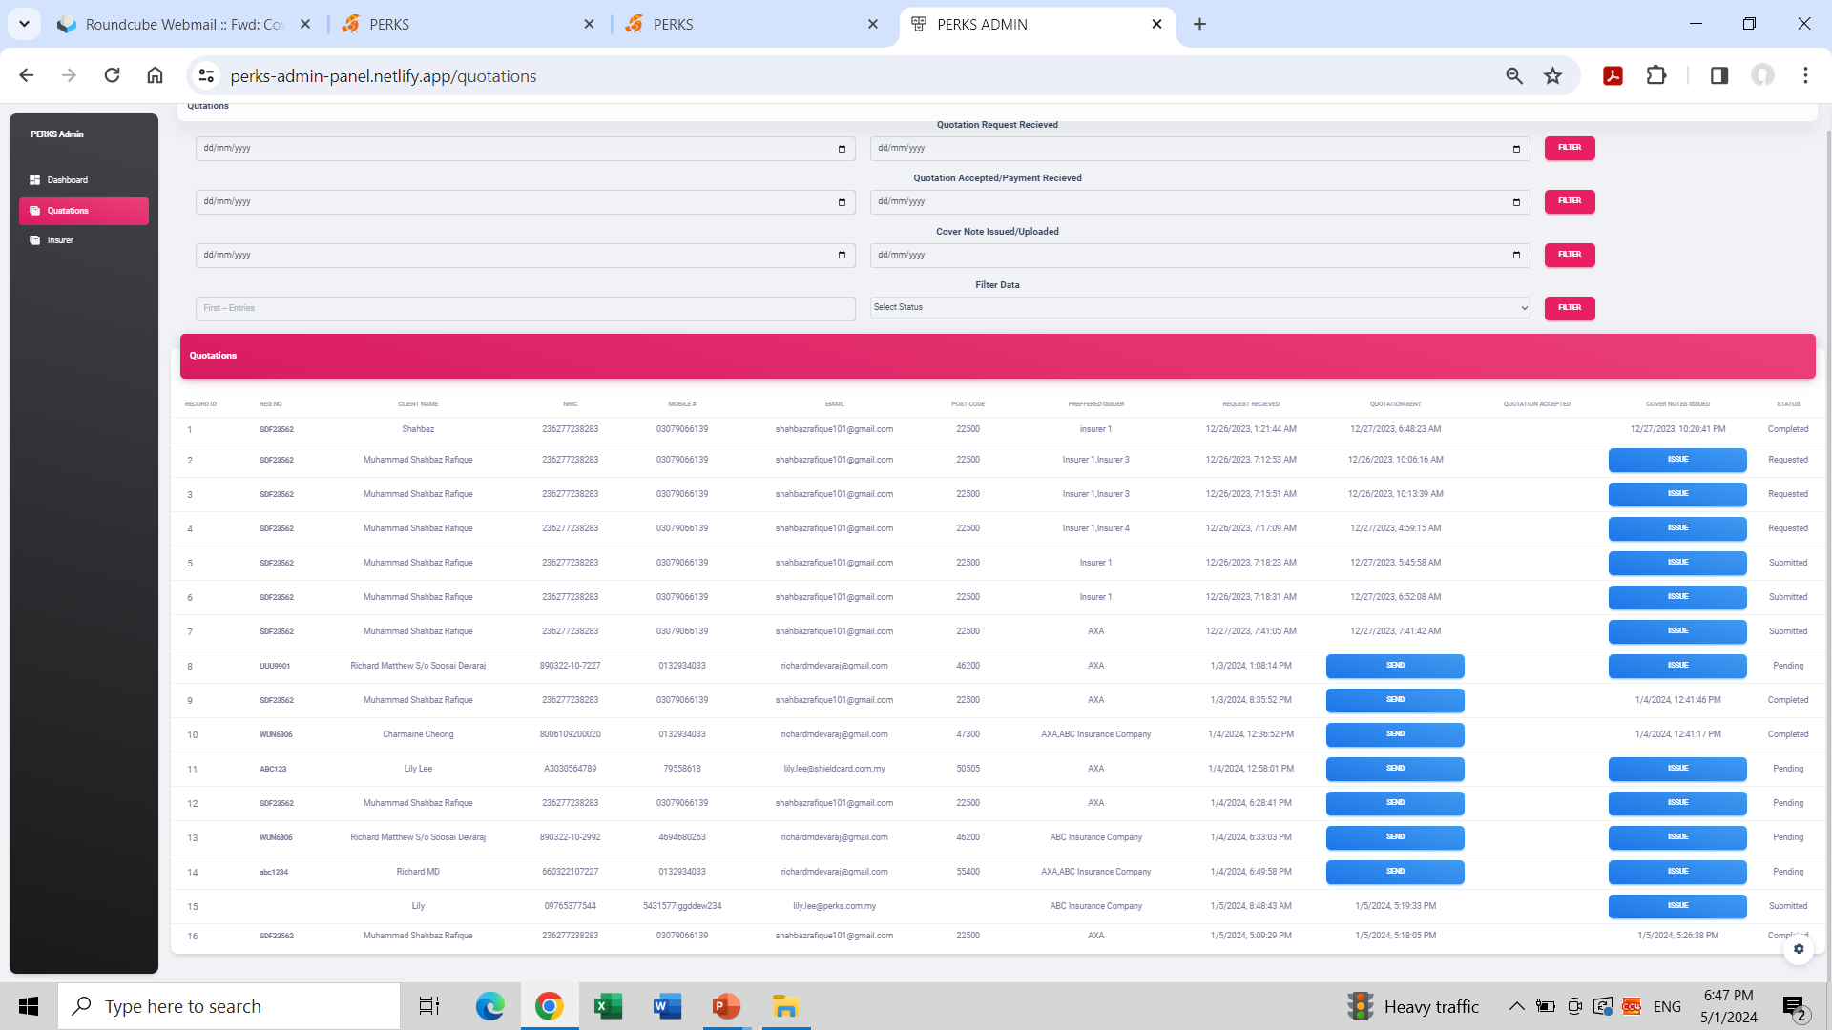
The above should only show the database/details of “Requests Received”. Should exclude everything else

Slide 4
The above should only show the database/details of “Quotations Sent”. Should exclude everything else

Slide 5
The above should only show the database/details of “Quotations Accepted”. Should exclude everything else

Slide 6
The above should only show the database/details of “Cover Notes Issued”. Should exclude everything else

Slide 7
PERKS Admin
Email No. 2

Slide 8
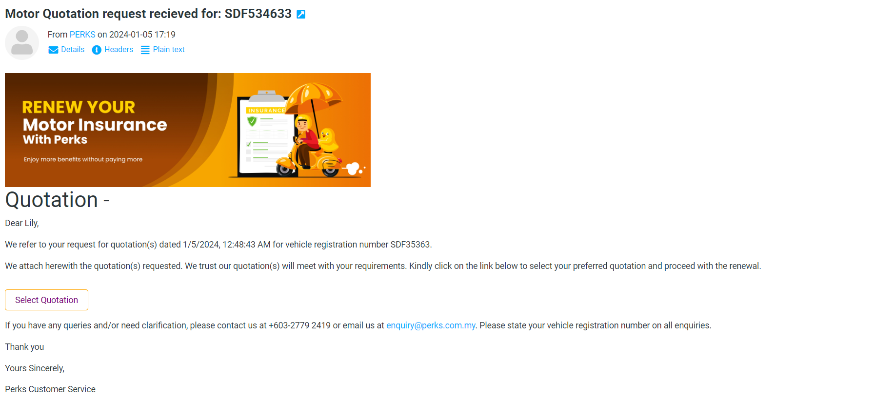

Slide 9
PERKS Admin
Quotation Sent

Slide 10
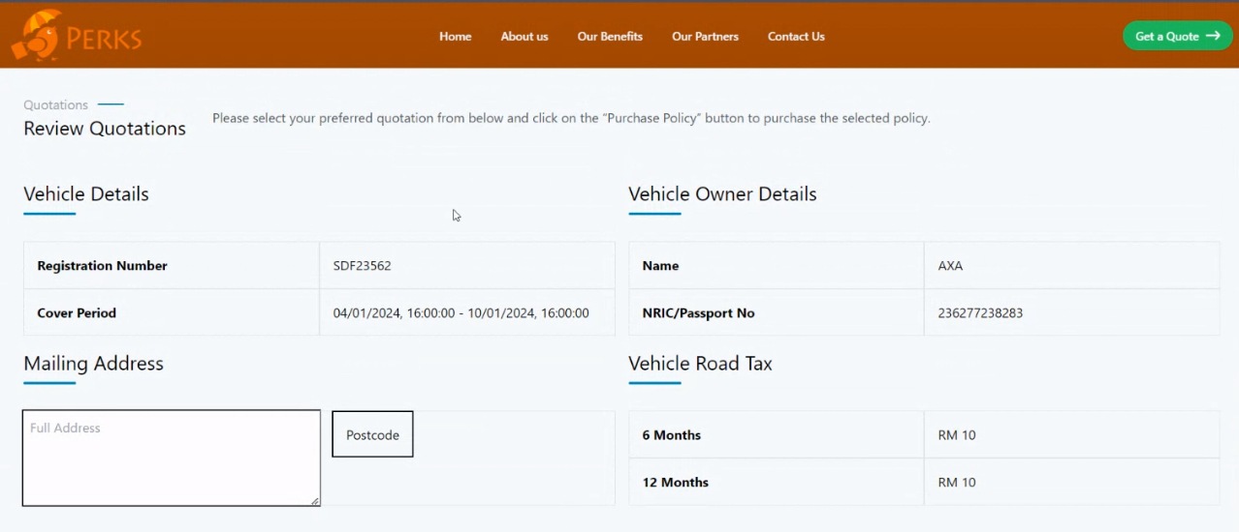
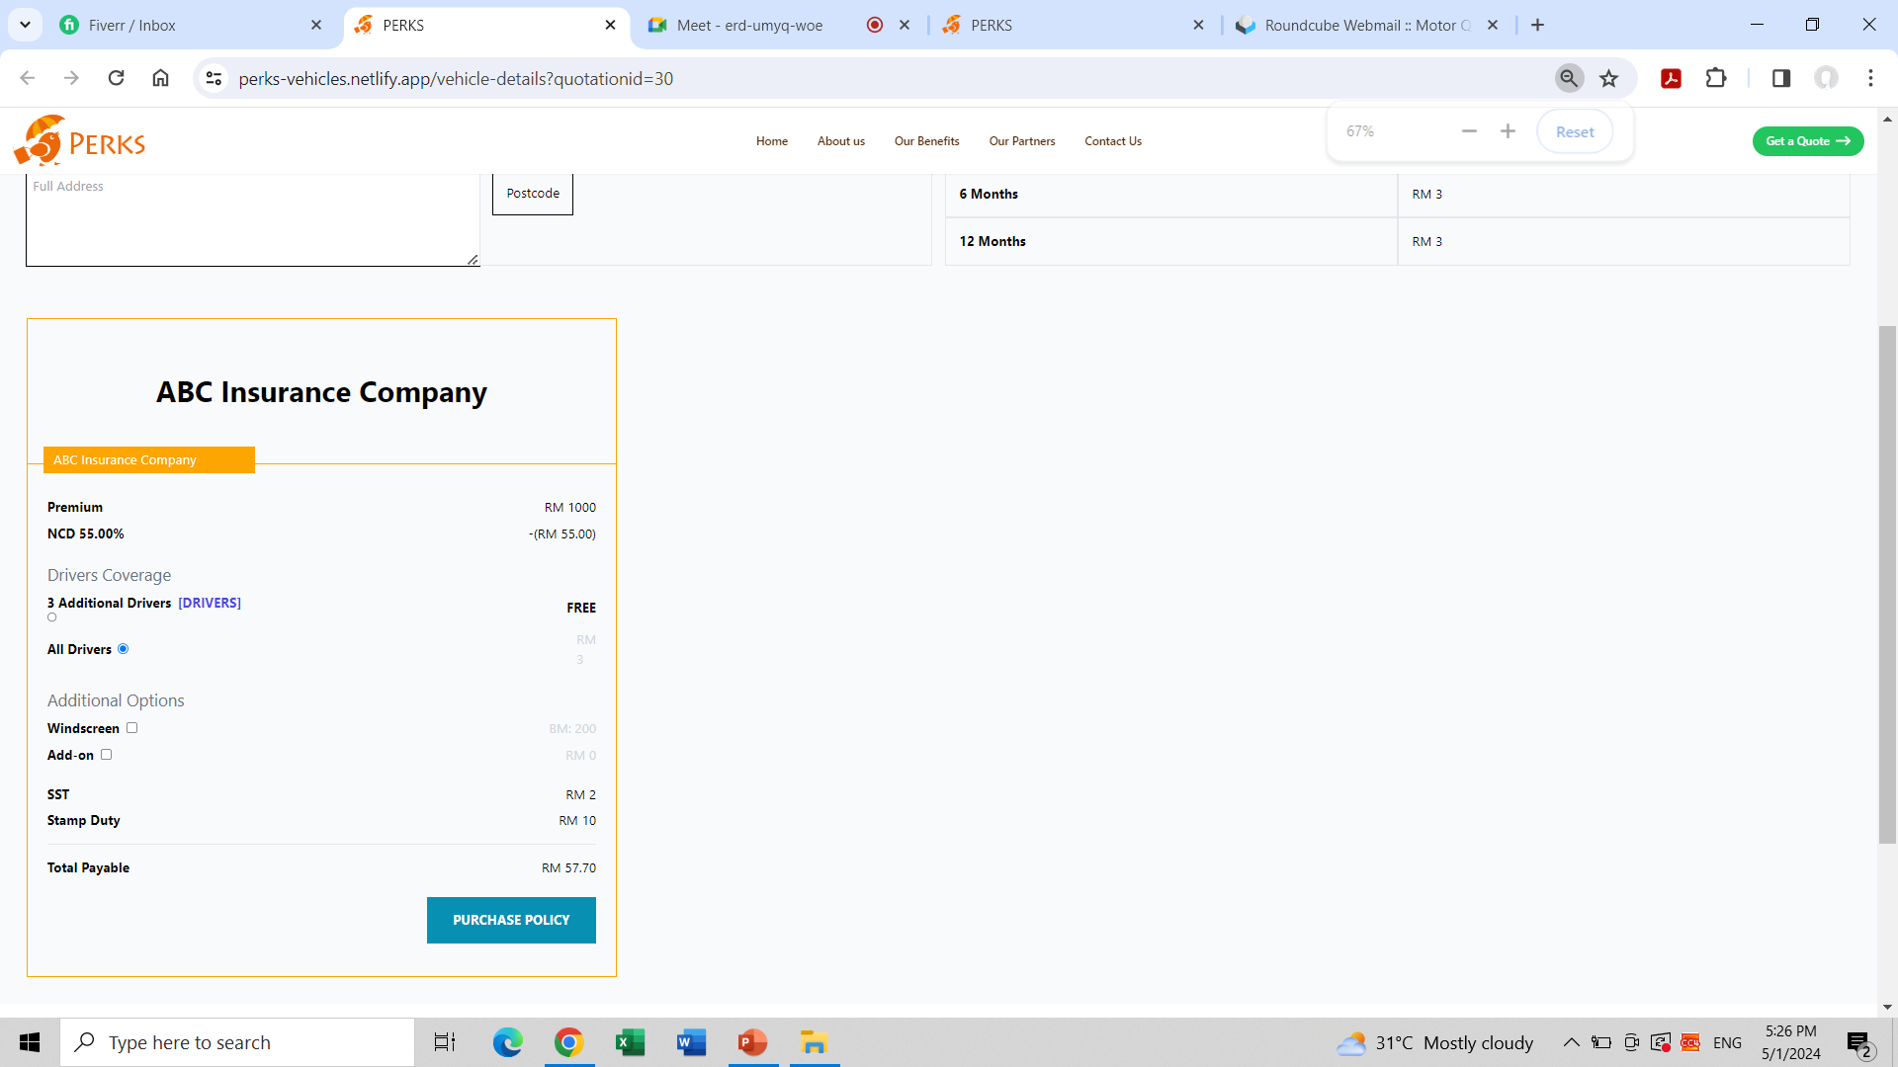
6 months
RM 15.00
12 months
RM 30.00
To change to this i.e. add box for customer to choose. Customer will click on either 6 months or 12 months, depending on their choice. If customer chooses 6 months (for example), the amount will appear on the summary below.
Name of Insurer No. 1
Name of Insurer No. 2
To change this part on Drivers Coverage
To change this part on Drivers Coverage
- 3 named drivers FREE
- All drivers RM 0.00
- 3 named drivers FREE
- All drivers RM 0.00
Driver no. 1 | Full Name | NRIC/Passport No.
Driver no. 2 | Full Name | NRIC/Passport No.
Driver no. 3 | Full Name | NRIC/Passport No.
Driver no. 1 | Full Name | NRIC/Passport No.
Driver no. 2 | Full Name | NRIC/Passport No.
Driver no. 3 | Full Name | NRIC/Passport No.
To change to Total Insurance Premium.
RM 15.00
To change to Total Insurance Premium.
RM 15.00
Road Tax
RM 72.70
Road Tax
RM 72.70
Total Payable
Total Payable
To change Total Payable to Total Insurance Premium
To include Road Tax
To include Total Payable → take note that Total Payable is Total Insurance Premium plus Road Tax.
To include PURCHASE POLICY at the end of this summary.

Slide 11
PERKS Admin
Email No. 3

Slide 12
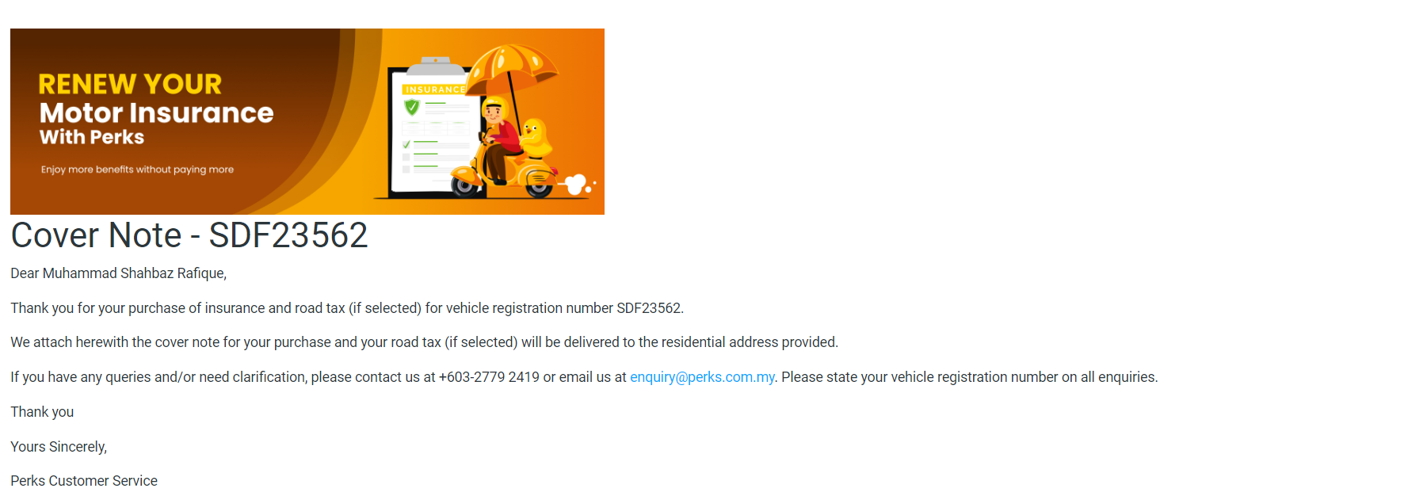
Change as follows;
“We attach…….(if selected) has been renewed.

